Slide 1
Plasticity: Pre-synaptic
Paul Kramer, 180424
Paul Kramer, 180424
Jeff Diamond

Slide 2
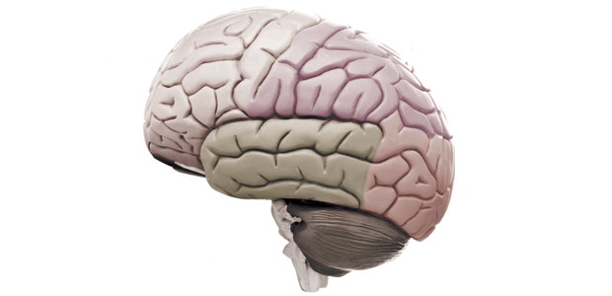
Importance of Plasticity
Thinking
Remembering
Learning
Addicting
Forgetting
No, not that kind of plastic…
Changeability, malleability

Slide 3
Question to get started
Why do neurons have chemical synapses?
At the NMJ, a single axon innervates a single muscle fiber and can RELAY a BINARY signal of “fire” or “don’t fire”
A electrical synapse could do the same thing… so why have messy chemicals at all?
Notes:
In the discussion / answer, get to idea of variable synaptic strengths

Slide 4
How to measure synaptic strength

Slide 5
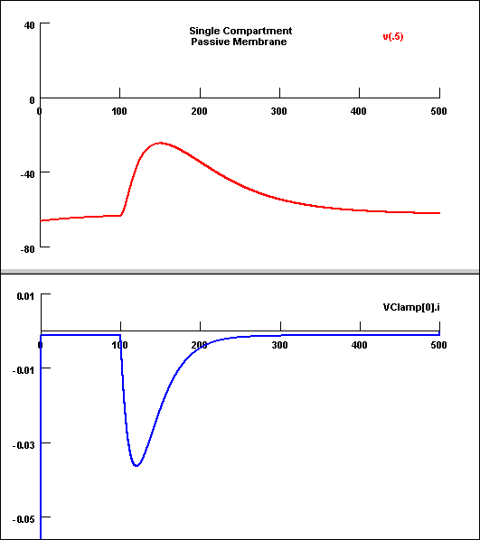
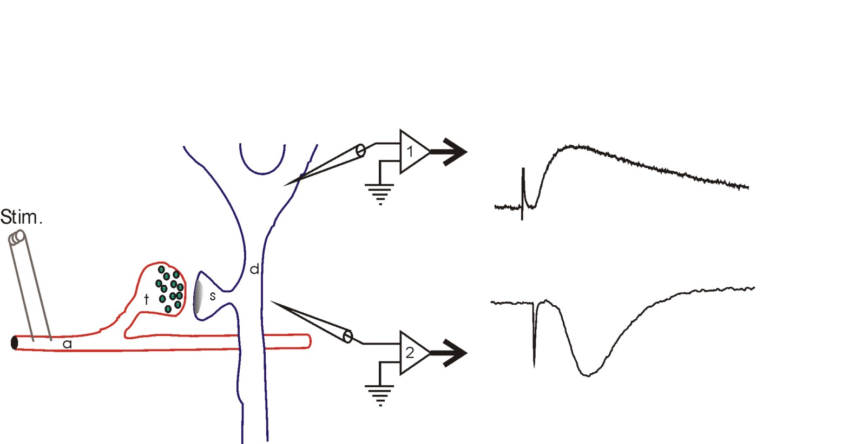
How to measure synaptic strength
Post-synaptic potentials (mV)
Field potentials (mV)
Post-synaptic currents (pA)

Slide 6


Plasticity: change in synaptic strength
strengthened
connection
weakened
connection

Slide 7
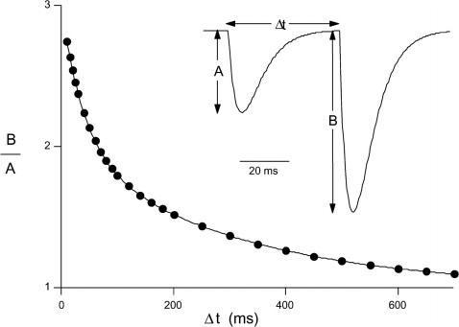
Measuring short term plasticity
PPR = B/A
PPF = B/A > 1
PPD = B/A < 1
no short term plasticity B/A = 1
Zucker and Regehr, 2002

Slide 8
Features of plasticity
INDUCED
Activity dependency – some sort of neural activity in the connected neurons themselves
Hormone, development, drugs, injury etc. can also induce plasticity
EXPRESSED
A change in the nature of the communication between neurons
PERSISTS
Short-term plasticity: seconds to minutes
Long-term plasticity: minutes to hours and even days

Slide 9
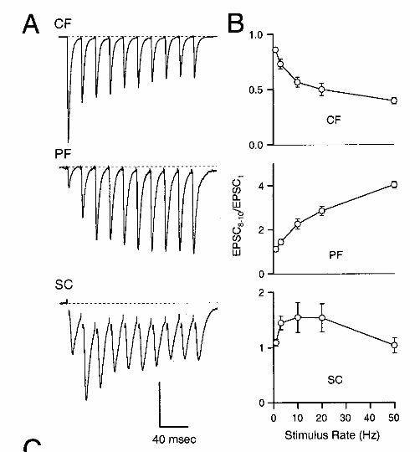
Many different expressions of plasticity
Climbing Fiber: Paired-pulse depression
Parallel Fiber: Paired-pulse facilitation
Schaeffer collateral: mixed expression

Slide 10
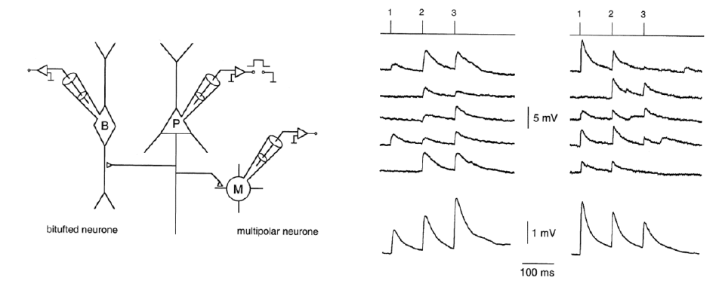
In some cases, you can measure PPF and PPD in one postsynaptic cell!
Rozov et al., 2001

Slide 11
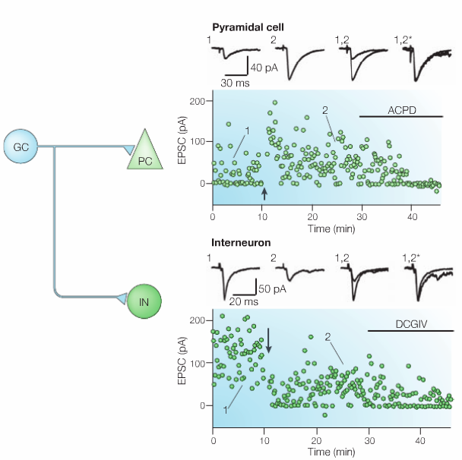
One cell can even have different expressions of plasticity onto two different cells!
Facilitation onto these neurons
Depression onto these neurons

Slide 12
Plasticity is highly regulated and variable
So let’s look at the different forms of plasticity more closely

Slide 13
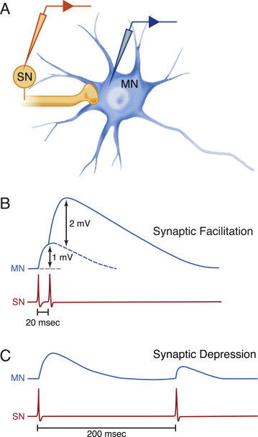
facilitation and depression (short term)
PPF
PPD

Slide 14
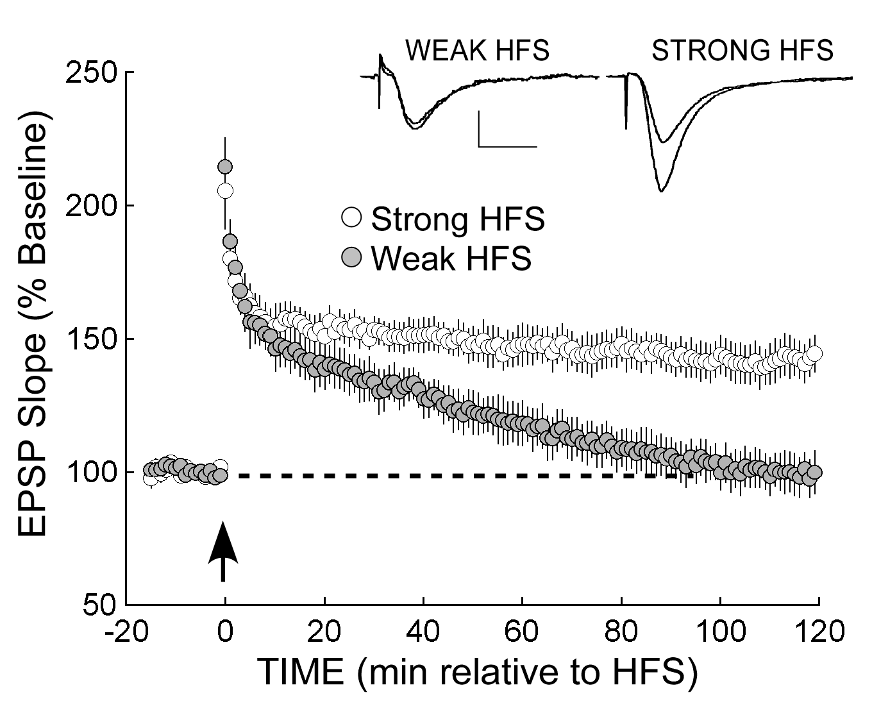
Post-tetanic plasticity (short term)
PTP
LTP
Tetanus = burst of stimuli
HFS = High frequency Stimulation
Tsokas et al., J. Neurosci. 25:5833 (2005)

Slide 15
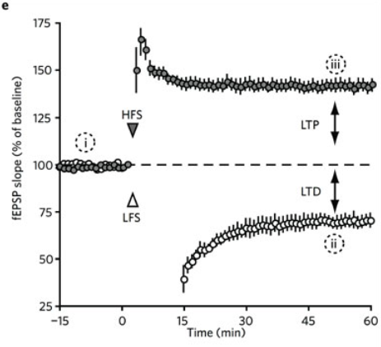
LTP and LTD (long term)
LTP = long term potentiation
LTD = long term depression
Flemming and England, nature chem biol (2010)

Slide 16
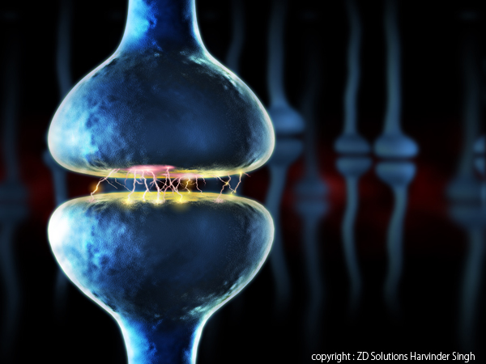
Where does plasticity occur?
Changes in pre-synaptic release
Changes in post-synaptic receptors

Slide 17
Discussion: plasticity location
Why would the location of plasticity matter?
How would more neurotransmitter release change the synapse compared to more receptors?

Slide 18
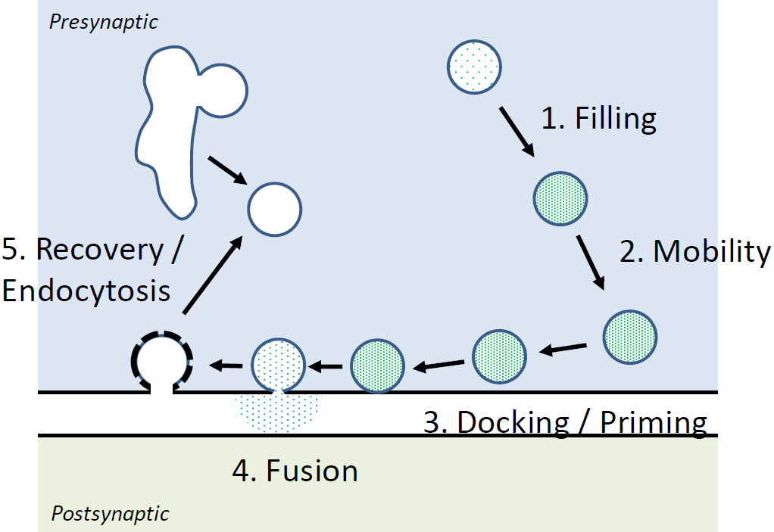
Mechanisms of presynaptic plasticity
Reducing release:
Paired pulse depression (PPD)
vesicle pool depletion
calcium channel inactivation
autoreceptors
Enhancing release:
Paired pulse facilitation (PPF)
residual calcium

Slide 19
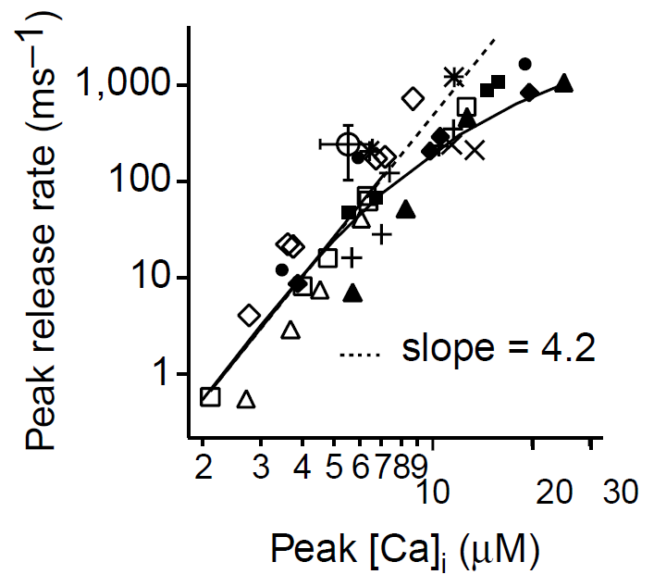
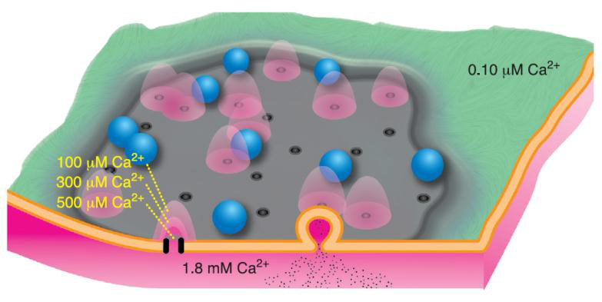
PPF: residual calcium
Calcium is necessary for vesicle release

Slide 20
PPF: residual calcium
Ca2+

Slide 21
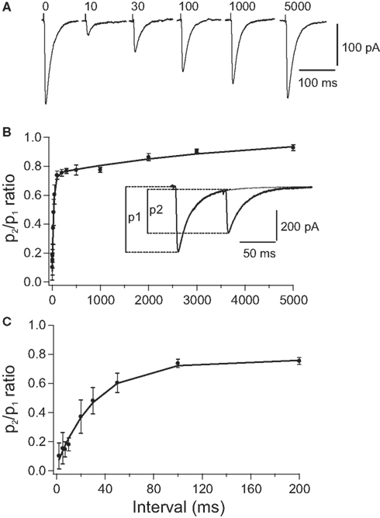
PPD: Releasable pool depletion
pre-synaptic
reserve
pool
post-synaptic
releasable pool

Slide 22
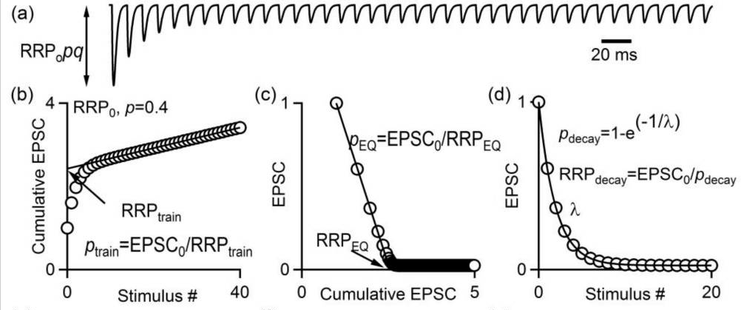
How to measure RRP?
Kaeser and Regehr, Curr. Op. Neurob. 2017

Slide 23
PPD: Inactivation of calcium channels
Ca2+
Calcium can inactivate calcium channels
Less calcium will enter on the second pulse

Slide 24
PPD: autoreceptors
GABA-A receptors provide one form of presynaptic depression.
But, convolutedly, GABA is usually DEPOLARIZING in the axon… how does this work?
Ideas?
Shunting inhibition
Na⁺ channel inactivation
?
-
+
-
-

Slide 25
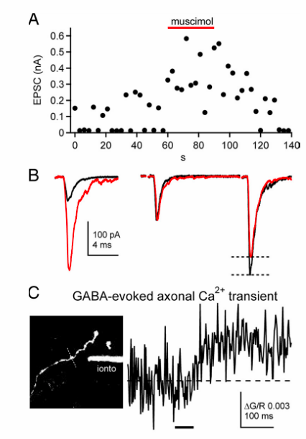
PPD: autoreceptors
GABA-A receptors can also enhance release: PPF
-
GABA-A agonist enhances EPSC amplitude
Effect on single EPSC and paired pulse
Accompanied by an increase in axonal Ca²⁺
+
-
-
Pugh and Jahr, J. Neuro 2011

Slide 26
Discussion
What does it mean when PPR changes?

Slide 27
Probability of release
Baumel et al., 2009

Slide 28
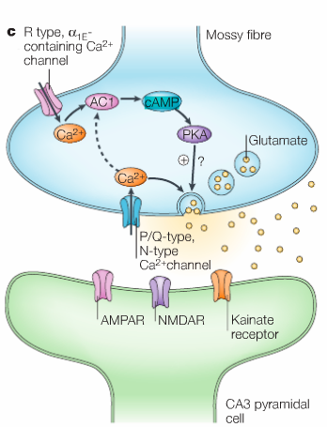
Contribution of signaling molecules
Adenylyl cyclase
PKA
cAMP
All can lead to changes in vesicle release…
cAMP is heavily involved in presynaptic facilitation
But until now it hasn’t been super clear how…

Slide 29
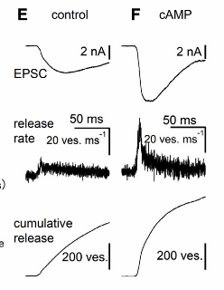
cAMP increases Pr
Paired recordings from presynaptic bouton and postsynaptic cell!
Adding cAMP to the presynaptic bouton:
increases postsynaptic EPSC
Increases vesicle release rate
Increases cumulative release
Midorikawa and Sakaba, 2017

Slide 30
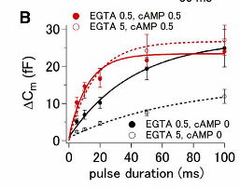
cAMP increases Pr
cAMP effect depends on… you guessed! CALCIUM!!
Their conclusion in that cAMP increases the association between synaptic vesicles and calcium channels
Midorikawa and Sakaba, 2017

Slide 31
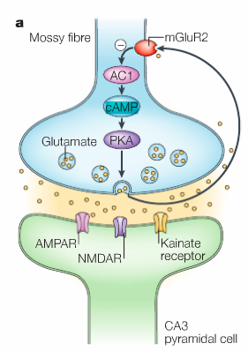
cAMP inhibition can lead to depression
Through a GPCR-mediate inhibition of cAMP production …
Which we’ll talk more about next week!

Slide 32
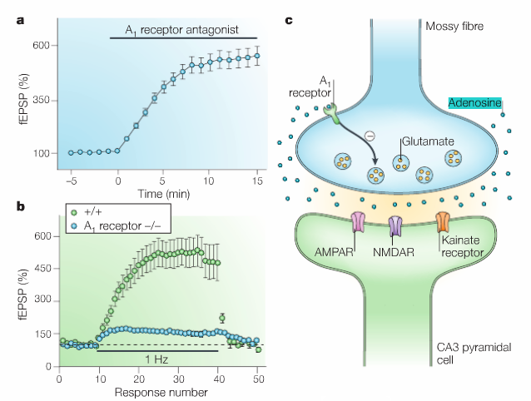
Adenosine tone gates presynaptic plasticity
Adenosine tone persistently suppresses release
A₁ receptor KO masks short term plasticity

Slide 33
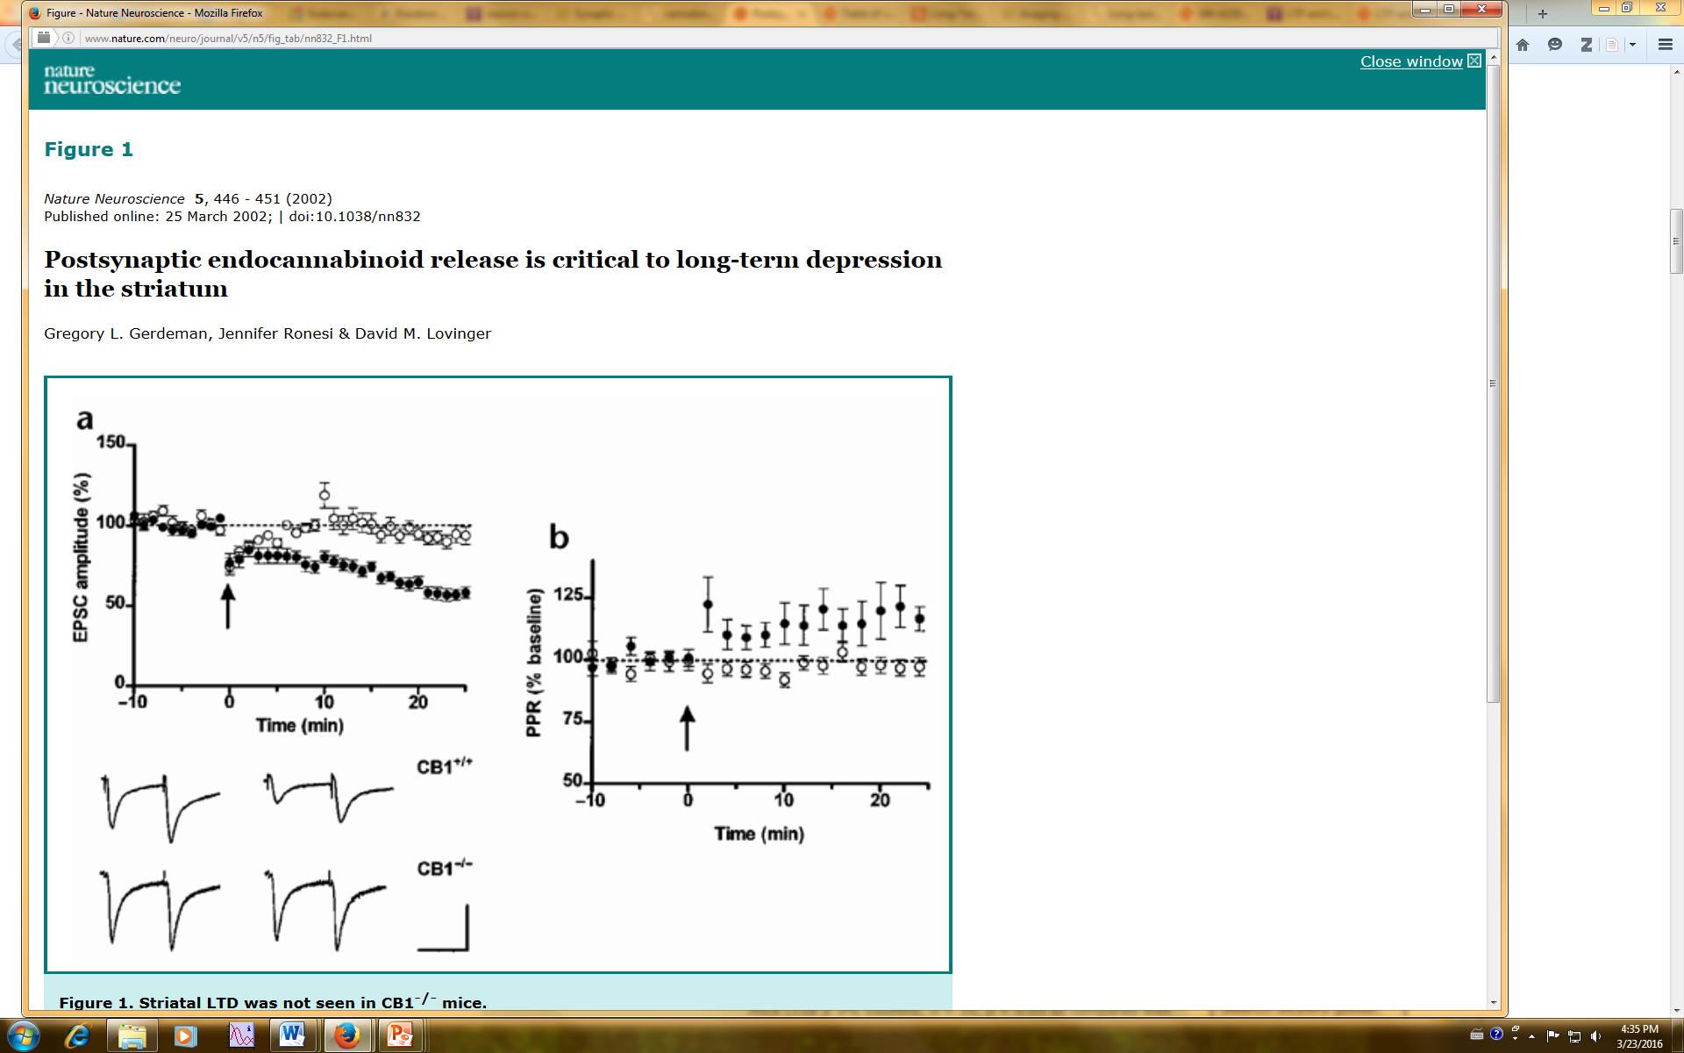
Long term presynaptic changes
Presynaptic GPCRs can also affect release
We’ll also get into this more next week…
Gerdeman et al., nature neurosci (2002)

Slide 34
What’s next?
That was all about the presynaptic side… next we’ll talk about the other side of things.
Think about Hebbian plasticity for next week. Neurons that fire together, wire together. What’s that mean?

Slide 35
my contact
paul.kramer@nih.gov

